Slide 1


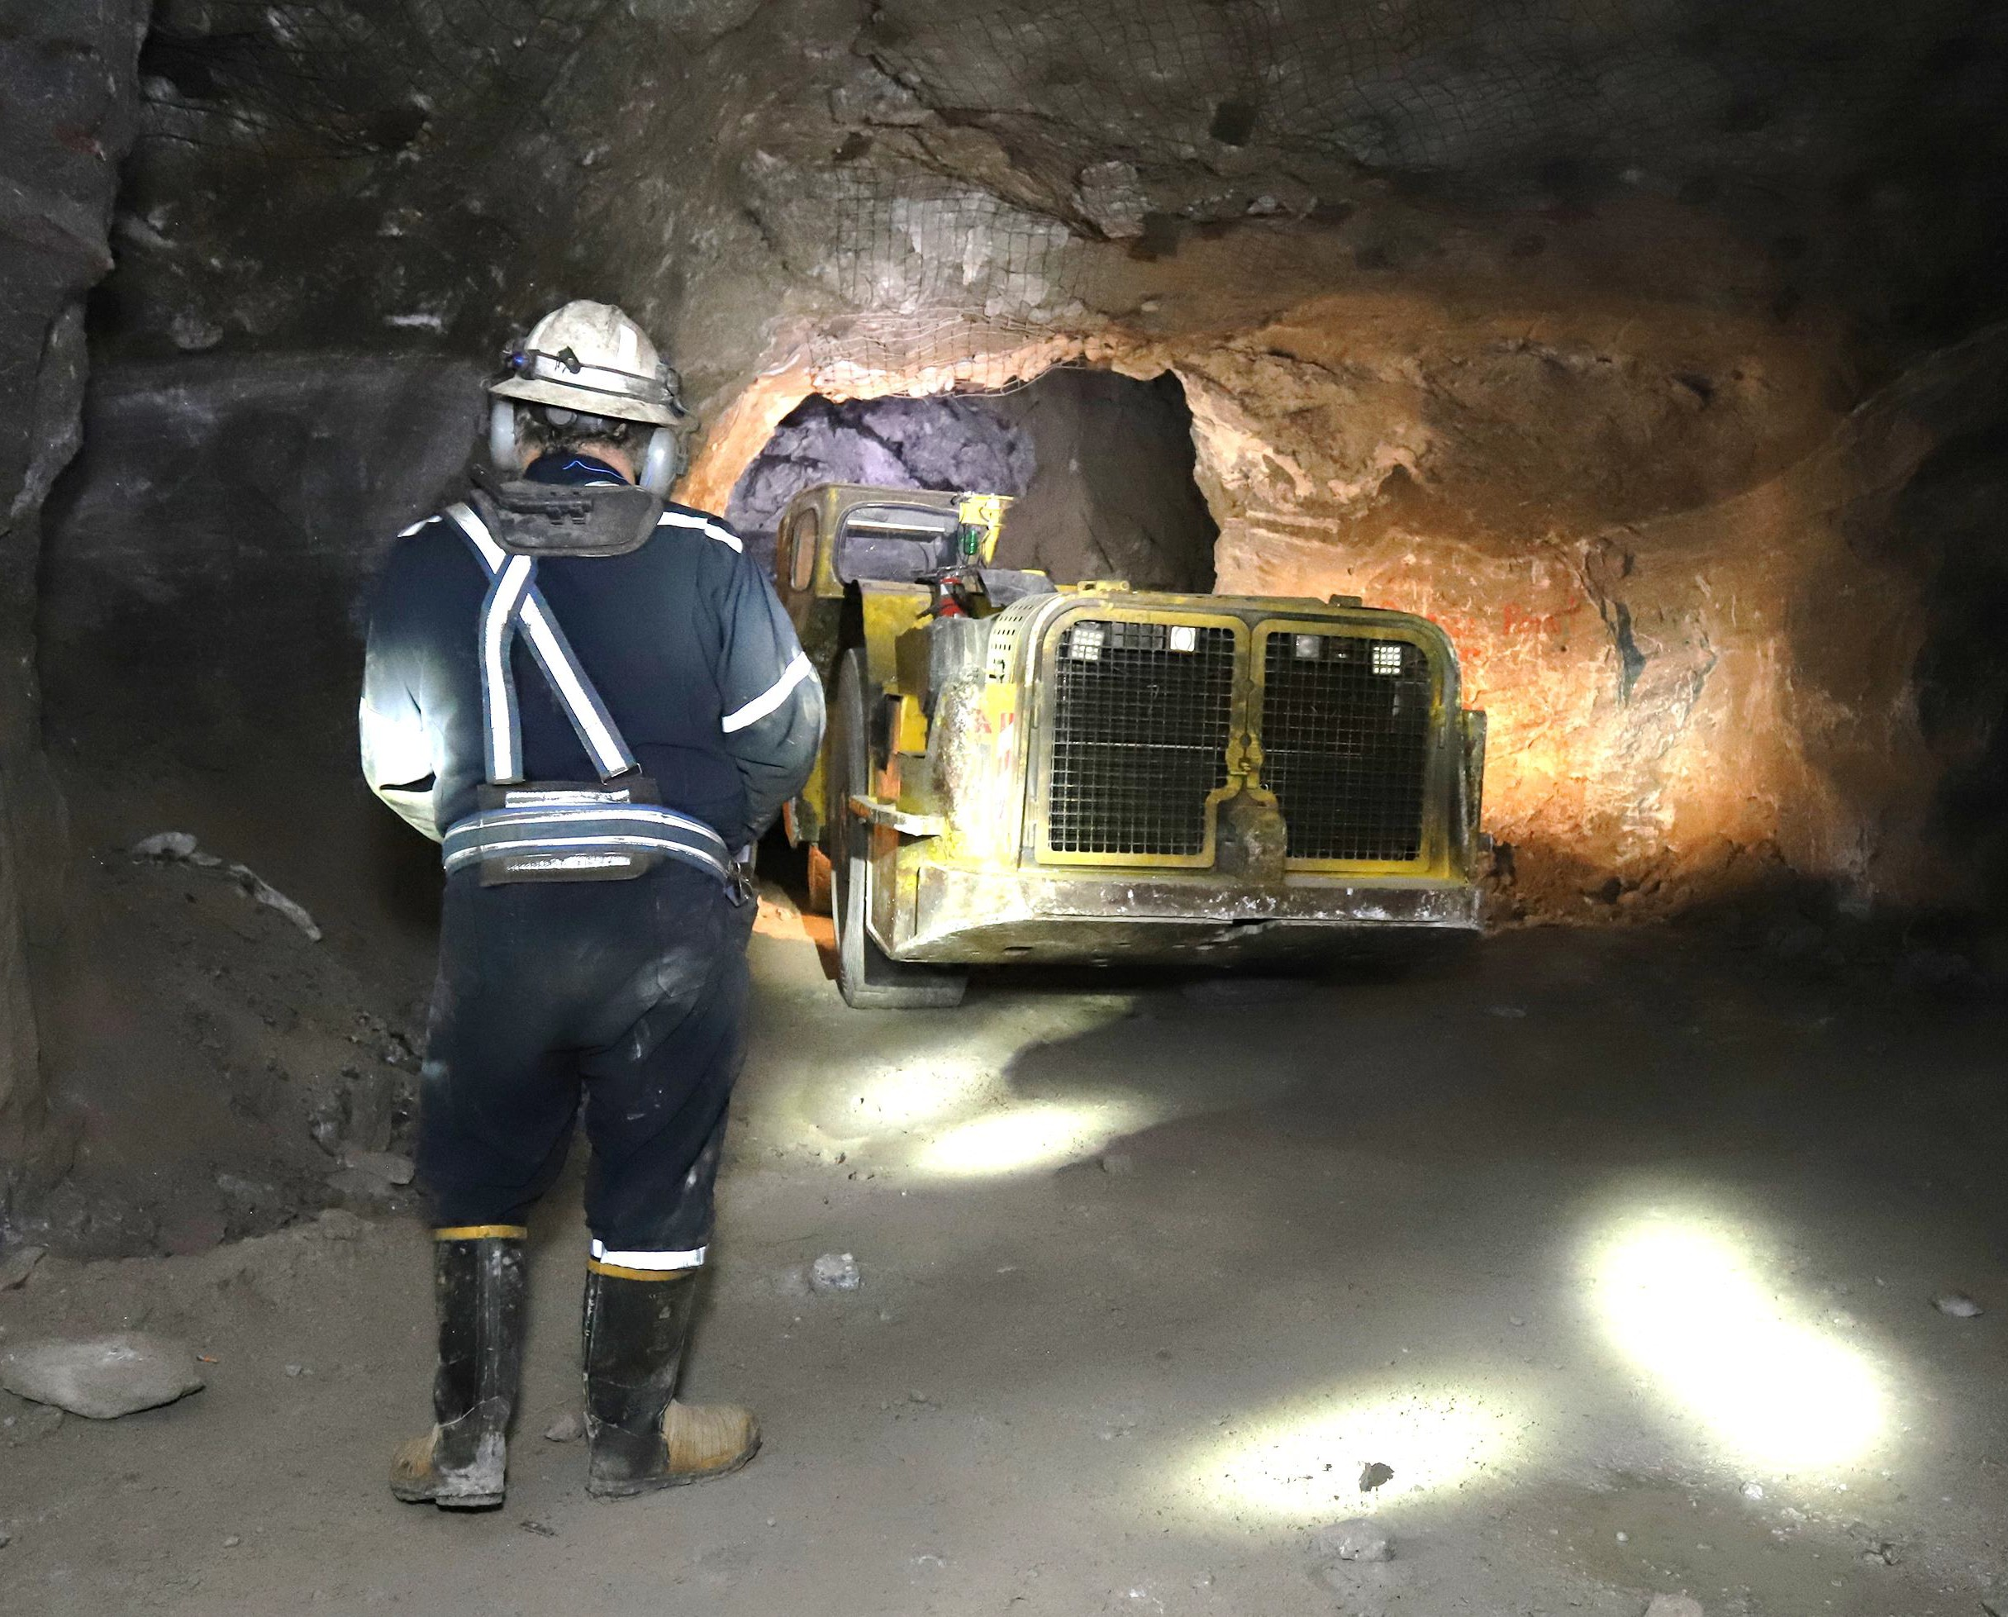


BUILT FOR GROWTH
A PROVEN TEAM DRIVEN BY VALUE AND COMMITTED TO EXCELLENCE
TSX: TI
December 2021

Slide 2





Cautionary Notes
Forward-Looking Information: political and regulatory stability; the receipt of governmental and third party approvals, licenses and This presentation contains "forward-looking information" within the meaning of Canadian permits on favourable terms; obtaining required renewals for existing approvals, licenses and securities laws. In some cases, forward-looking information can be identified by the use of permits and obtaining all other required approvals, licenses and permits on favourable terms; forward-looking terminology such as "plans", "targets", "expects", "is expected", "unique sustained labour stability; stability in financial and capital goods markets; availability of equipment investment opportunity”, "is positioned" or "assumes", or variations of such words and phrases and the condition of existing equipment being as described in the Technical Report; the absence of or state that certain actions, events or results "may", "could", "would" or "will" occur or be any long-term liabilities created by the mining activity in the Balmat region beyond those described achieved. In addition, any statements that refer to expectations, predictions, indications, in the Technical Report; the accuracy of the Company's accounting estimates and judgments; the projections or other characterizations of future events or circumstances contain forward-looking impact of adoption of new accounting policies; the Company's ability to satisfy the terms and information. Statements containing forward-looking information are not historical facts, but conditions of its indebtedness; and the timing of a revised mine plan for ESM. There can be no instead represent management's expectations, estimates and projections regarding future assurance that such estimates and assumptions will prove to be correct. In addition, if any of the
events.
assumptions or estimates made by management prove to be incorrect, actual results and developments are likely to differ, and may differ materially, from those expressed or implied by the
Forward-looking information includes, among other things, statements relating to: estimated C1 forward-looking information contained in this presentation. Accordingly, readers of this presentation
cash costs and AISC; future financial or operating performance and condition of the Company, are cautioned not to place undue reliance on such information. including its ability to continue as a going concern, and its business, operations and properties;
the Company's ability to implement its growth strategy to maximize the value of its property Forward-looking information is necessarily based on a number of the opinions, assumptions and holdings; the Company's planned exploration and development activities at Empire State Mine; estimates that, while considered reasonable by the Company as of the date such statements are costs, timing and results of future exploration and drilling; forecasted trends in the global zinc made, are subject to known and unknown risks, uncertainties, assumptions and other factors that market, including in respect of the price of zinc; capital and operating cost estimates; economic may cause the actual results, level of activity, performance or achievements to be materially analyses (including cash flow projections) from the Technical Report; the adequacy of the different from those expressed or implied by such forward-looking information, including but not Company's financial resources; the estimation of mineral resources; the realization of mineral limited to the following factors described in greater detail under the heading "Risks Factors" in the resource estimates; the probability of inferred mineral resources being converted into measured Company’s most recent Annual Information Form available at www.sedar.com: limited operating or indicated mineral resources; the production schedule for the Empire State Mines (“ESM”) #4 history; dependence on ESM; refurbishment of the mine and mill; inherent risks of mining; mine; the timing of completion and results of drift rehabilitation and refurbishment of ESM #4 estimates of mineral resources; production decisions based on mineral resources; uncertainty in mine; production estimates for ESM #4 mine; the Company's plans for marketing of zinc relation to inferred mineral resources; fluctuations in demand for, and prices of, zinc; production concentrate produced at the Empire State Mine and mill; any updates to the mine plan for ESM projections and cost estimates for ESM #4 mine may prove to be inaccurate; future requirements #4 mine and continuation of the drill program at the Empire State Mine; timing, receipt and for additional capital; profitability of the Company; ability to attract and retain qualified maintenance of approvals, consents and permits under applicable legislation; the Company's management; title; competition; governmental regulations; market events and general economic ability to re-negotiate expired leases and the timing thereof; environmental, permitting, legal, conditions; environmental laws and regulations; threat of legal proceedings; rights, concessions and taxation, title, socio-economic, community relations or political issues that may adversely affect permits; social and environmental activism; land reclamation requirements; Tailings Management the Company's current and anticipated operations; the Company's expectations with respect to Facility and environmental reclamation; insurance; undisclosed liabilities; health and safety; the payment of dividends; the Company's ability to make scheduled payments of the principal, dependence on information technology systems; zinc hedging activities; conflicts of interest; risks or to pay interest on or refinance its indebtedness; the Company's expectations with respect to inherent in the Company's indebtedness; risks inherent in acquisitions; integration of the mine principal shareholders; and the Company's expectation that it will be able to continue to locate assets; labour and employment retention/relations; anti-corruption and bribery regulation, including and retain employees and consultants with required skills and knowledge. ESTMA reporting; infrastructure; enforceability of judgments; absence of a market for the common
shares; fluctuations in price of the common shares; loss of entire investment; significant ownership Forward-looking information is based on opinions, assumptions and estimates made by the by Richard W. Warke; future sales of common shares by Richard W. Warke and other directors and Company in light of its experience and perception of historical trends, current conditions and officers of the Company; use of proceeds; payment of dividends; currency exchange rate risks; pro expected future developments, as well as other factors that the Company believes are forma financial information; public company status; financial reporting and other public company appropriate and reasonable in the circumstances, as of the date of this presentation, including, requirements; dilution; and securities analysts' research or reports could impact the price of the without limitation, assumptions about: equity and debt capital markets; the ability to raise any common shares. These factors and assumptions are not intended to represent a complete list of the necessary additional capital on reasonable terms; future prices of zinc, gold and other metals; factors and assumptions that could affect the Company. These factors and assumptions, however, the timing and results of exploration and drilling programs; the likelihood of discovering new should be considered carefully. Currency is in US dollars and tonnage is in short tons unless mineral resources in the Balmat-Edwards district; the accuracy in the Technical Report of the otherwise indicated. Other than as required by securities laws, Titan assumes no responsibility for mine production schedule; the estimated time of completion of drift rehabilitation and updating the forward-looking information in this presentation.
refurbishment of ESM #4 mine; the production estimates; the geology and geophysical data of
ESM; the metallurgical forecast; the economic analysis, capital and operating cost estimates; Scientific and Technical Information:
the accuracy of any mineral resource estimates; the successful integration of ESM into the The scientific and technical information in this presentation has been approved by Mr. Scott Burkett. Company's business; availability of labour; the accuracy of drill sample results at ESM; future Mr. Burkett, Vice President of Exploration for Titan, is a qualified person as defined by National
currency exchange rates and interest rates; operating conditions being favourable;
Instrument 43-101 (NI 43-101). Mr. Burkett has over 12 years of mineral exploration experience and is a Registered Member through the SME (registered member # 4229765).

Slide 3





Overview
Focus on exploration and development;
driven by best-in-class leadership
Empire State Mine (ESM), NY State
  100%-owned zinc producer in historic mining district
H2/21 production forecasted at 26M
payable lbs at AISC¹ of US$0.88/lb
In the process of developing near-mine open-pit resources
H2/21 strategy to retire portion of debt and
initiate inaugural dividend
Part of the Augusta Group – strong track
record in exploration and development
Empire State Mine, New York
•
Toronto Stock Exchange Symbol | TI
Shares Outstanding (08/10/2021) | 139 M
Fully Diluted Shares Outstanding (08/10/2021) | 170 M
Market Capitalization (as of 08/10/2021) | C$42 M
1. AISC is a non-GAAP measure. See the Company’s most recent MD&A for discussion of non-GAAP measures.

Slide 4

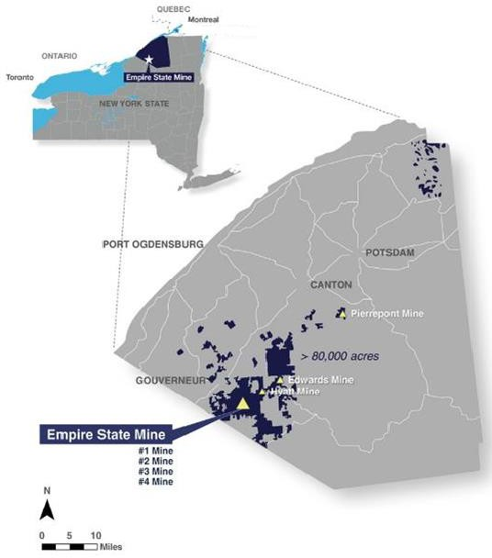
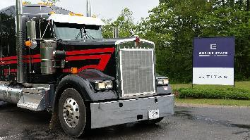
Empire State Mine:
Focused on Exploration in a 100-Year-Old Zinc District
Producing zinc concentrate
Local employer, benefiting St.
Lawrence County in northern New York
Long-term zinc concentrate offtake agreement with Glencore – transportation within North America
Historic production – 44M tons milled at average grade of 9.4% zinc from 7 mines within 30-mile radius of mill
>80,000 acres of mineral rights controlled throughout district
Pierrepont Mine
Edwards Mine Hyatt Mine
#4 Mine #2D Zone
Shipment of zinc concentrate leaving site
OPERATIONAL EXCELLENCE

Slide 5

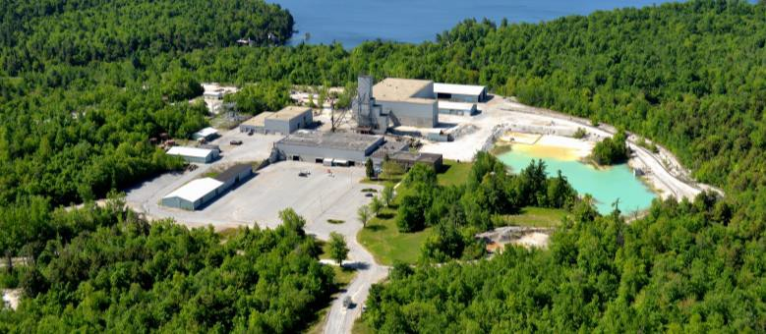
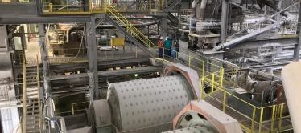
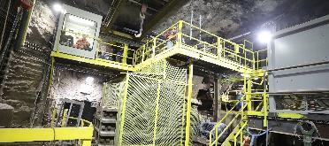
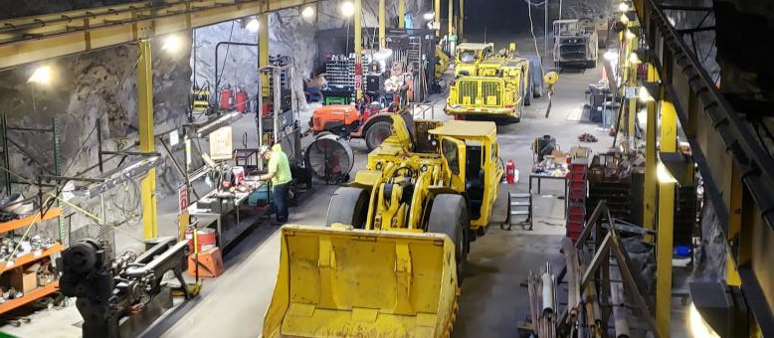
Empire State Mine:
Near-Mine and District Exploration
Production supported by current mineral resources with potential for near-mine resource additions
  Current source is ESM #4 mine – multiple zones in production; Mahler, New Fold and Mud Pond
  Mining has recommenced on the #2D zone
  Surface drilling has discovered Little York, new high-grade zinc mineralization zone between Mud Pond and the historically mined Upper Fowler zone
  Future discovery potential through additional near-mine exploration
Targeting large, high-grade deposits (15 to 30+ Mt at 10% zinc) – new ideas and modern approach to exploration led by award-winning team
Office building and 3,800 tpd shaft
5,000 tpd processing plant
Underground crusher at 3,100 level
Fully equipped maintenance shop capable of servicing all equipment
OPERATIONAL EXCELLENCE

Slide 6
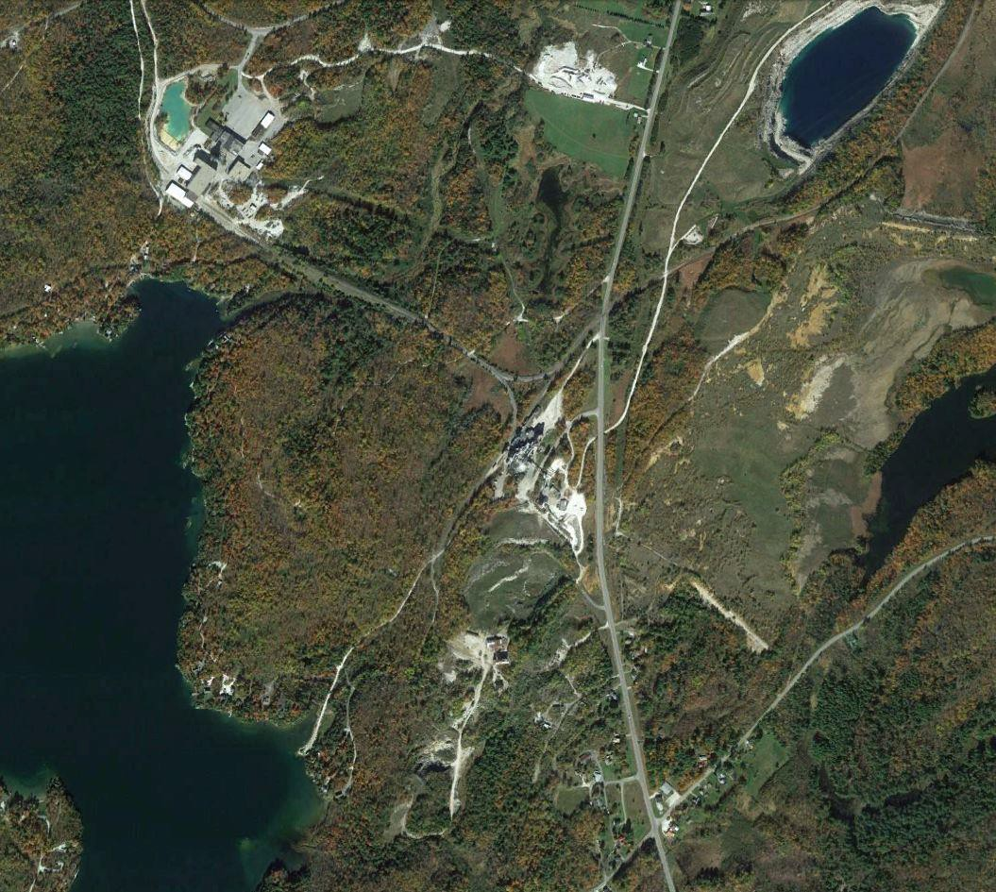




Empire State Mine:
Potential Near-Term Incremental Mill Feed
Pumphouse and Turnpike
Shallow zones of near-mine open-pit mineralization discovered in Nov 2019
ESM #4 Mine / Mill Complex
Potential to add low-cost production
Strategic zones to achieve Company’s strategy of providing feed to ESM mill with over 3,000 tpd in an effort to increase production and lower costs
Future discovery potential through additional near-mine exploration
Production anticipated in 2022
N
Turnpike
Pumphouse
1 Mile
OPERATIONAL EXCELLENCE

Slide 7

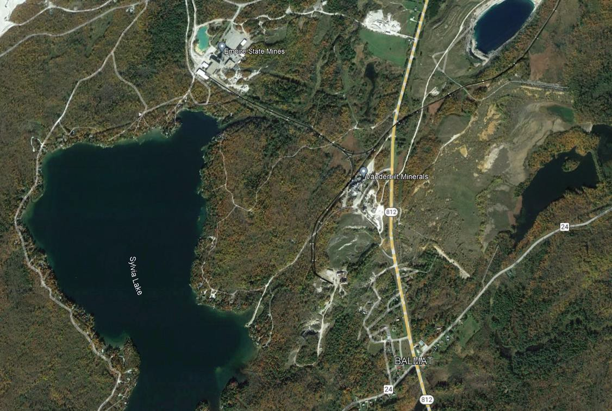










Geographic Overview
Former Arnold Pit
Former #1 Pit
#2 Shaft
Turnpike Deposit
Pump House Pit
SPHALEROS

Slide 8
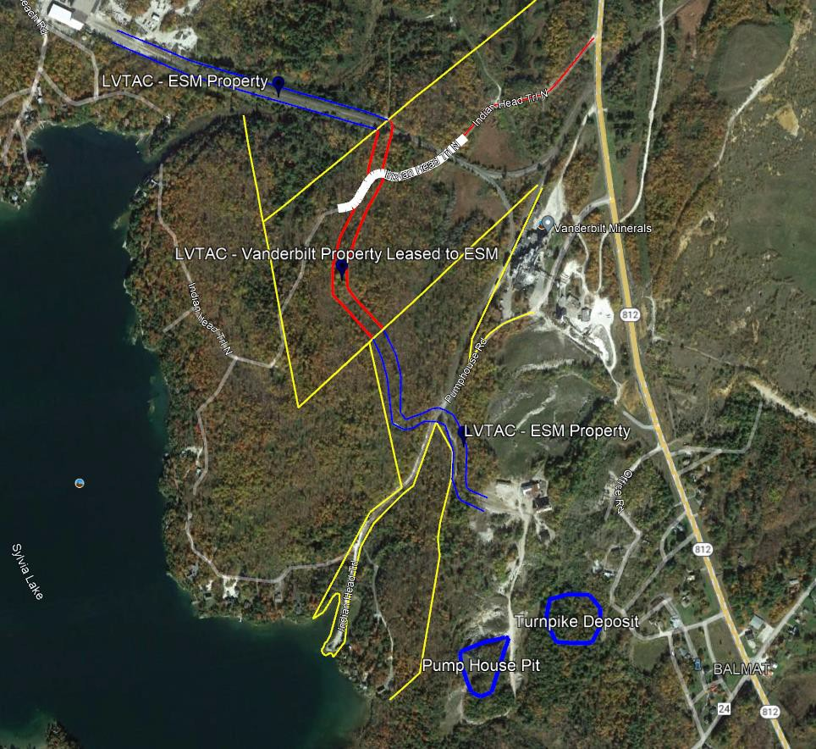
Low Volume Temporary Access Corridor (LVTAC)
SPHALEROS

Slide 9
LVTAC Right-of-Way Priorities
Emergency Vehicles
  State, Municipal, ESM Mine Rescue.
  When Emergency Lights are On.
Sylvia Lake Residents at East Shore Road and Pump House Road
  Intersections only
  (Currently evaluating Traffic Control and
Proximity Detection Systems)
Haul Trucks
Support vehicles
All other light duty vehicles.
SPHALEROS

Slide 10
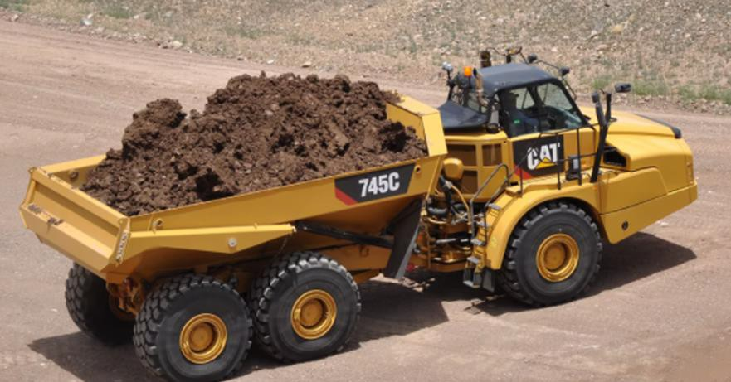
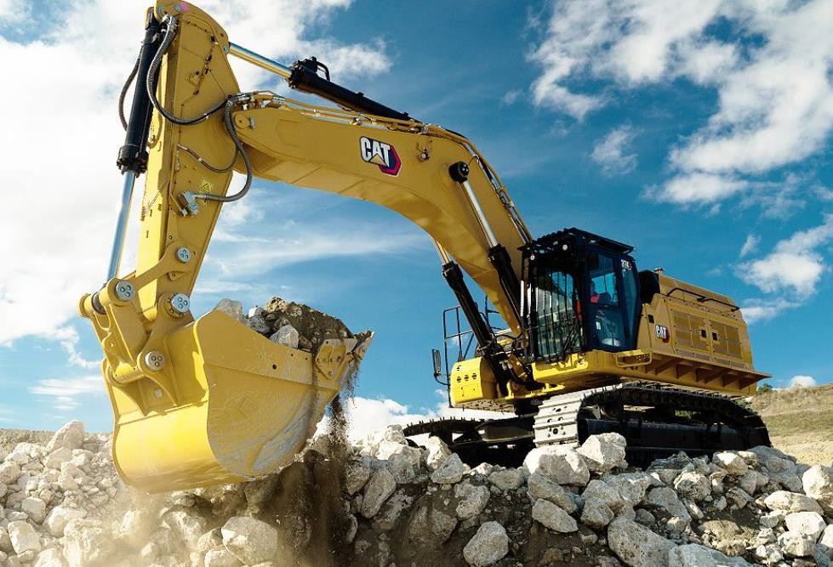
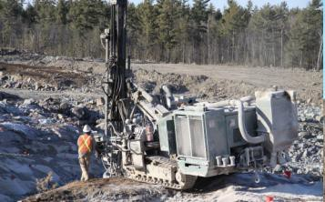
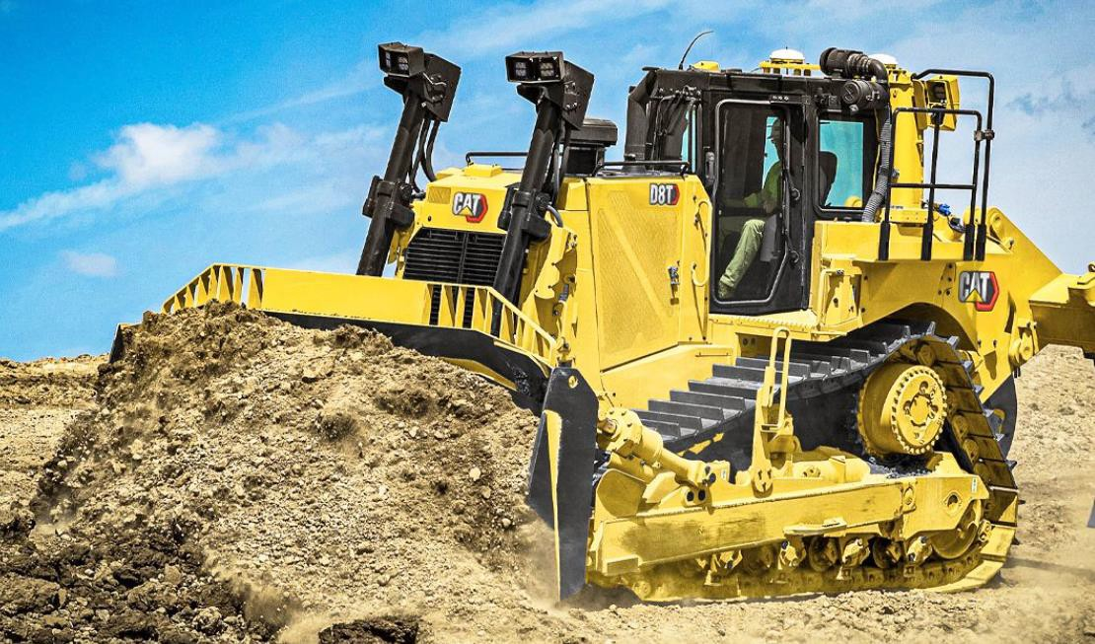
Heavy Equipment
3 - Haul Trucks – 45 Ton 1 – D8 Dozer
1 - Excavator – 5 cu yd 1 - Surface Drill
SPHALEROS

Slide 11
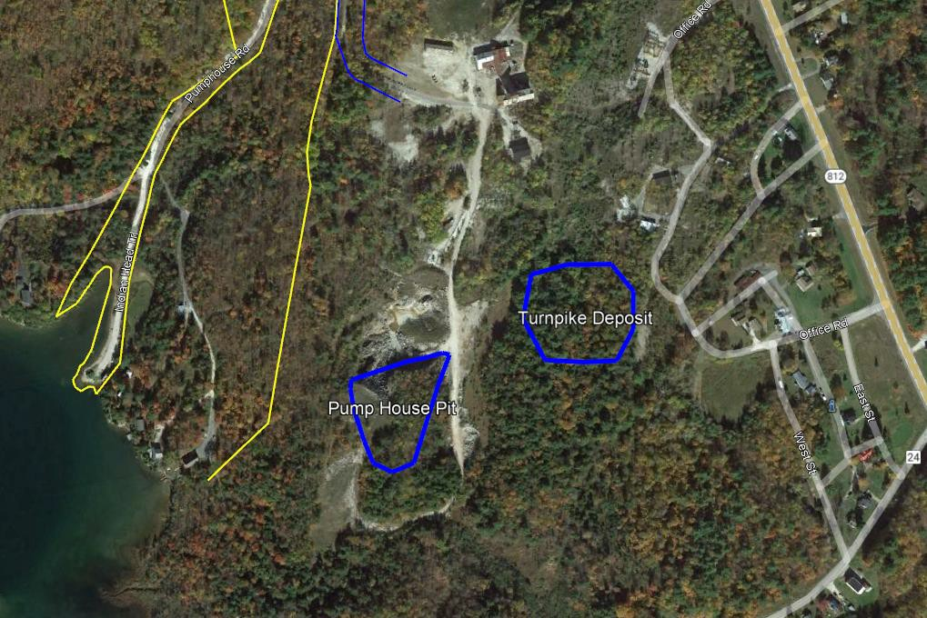
Pump House Pit
SPHALEROS

Slide 12
Positive Impacts
Building of LVTAC is aimed at not having surface dump trucks on Pump house road and state
highways, safer and less road maintenance.
Annual payroll that is put back into our community = currently employ 127 employees with good pay, benefits, etc. Positive on families, housing, shopping, stores, restaurants, etc
Entire project is run by a female engineer, supporting women in mining.
Earthworks contractor is former Gouverneur resident (his parents still live in area)
  Several Contractor Miners are local to Gouverneur
75% of Contractors (money being spent) is within NY State over $5M planned for 2022
  Contractors need goods and services from local businesses (lodging, food, fuel, equipment parts, etc)
Availability of training and skills development of local workforce
Provides field classrooms for local universities
Solidifying the area as a world source of Zinc; additional exploration, additional investment
translates into longer life for the mine and the benefits to the community.
SPHALEROS

Slide 13
FOR MORE INFORMATION
CONTACT:
www.titanminingcorp.com
Community Relations Phone: 1-800-632-9709
TSX: TI

